Slide 1
Credit Risk Modeling
GROUP 11
Krishna Panchal KNP230005
Sai Hemalatha Ramidi SXR240040
Thanh Luu TXL240006

Slide 2
Executive Summary
OBJECTIVE: Create an efficient default prediction model using XGBoost while finding a balance between increasing revenue and lowering credit card defaults.
Key Accomplishments:
Built a robust model that anticipates defaults with a 94% accuracy rate.
By detecting high-risk clients, our methodology enables proactive risk control.
Impact: Our XGBoost model greatly improves financial organizations' decision-making. It reduces losses, promotes regulatory compliance, and strengthens data-driven tactics.
 | Threshold | Train |  |  | Test 1 |  |  | Test 2
 |  | #Total | Default Rate | Revenue | #Total | Default Rate | Revenue | #Total | Default Rate | Revenue
Conservative Strategy | 0.1 | 64248 | 0.012922 | 2802.62 | 13767 | 0.011050 | 121.40 | 13768 | 0.011406 | 125.90
Aggressive Strategy | 0.3 | 64246 | 0.066485 | 3925.65 | 13767 | 0.064432 | 175.06 | 13768 | 0.065989 | 179.15

Slide 3
Data
 | months_of_data | Observations | default_rate
0 | all applications | 1107082 | 0.246498
1 | applications with 13 months of historical data | 1025914 | 0.229665
2 | applications with 12 months of historical data | 15733 | 0.470760
3 | applications with 11 months of historical data | 8105 | 0.484687
4 | applications with 10 months of historical data | 11569 | 0.493628
5 | applications with 9 months of historical data | 10377 | 0.460877
6 | applications with 8 months of historical data | 8655 | 0.470534
7 | applications with 7 months of historical data | 6200 | 0.454443
8 | applications with 6 months of historical data | 5781 | 0.446281
9 | applications with 5 months of historical data | 4499 | 0.405495
10 | applications with 4 months of historical data | 3603 | 0.443693
11 | applications with 3 months of historical data | 3376 | 0.349913
12 | applications with 2 months of historical data | 2286 | 0.315836
13 | applications with 1 months of historical data | 984 | 0.331301
We have chosen to use data spanning 13 months, from March 2017 to March 2018, for our credit risk model. We have adequate historical data from this period to record a variety of consumer trends and financial circumstances.
The target variable in this model represents whether a customer will default in the following 12 months.

Slide 4
Features
Features Description:
• Delinquency Variables: these indicate historical credit behavior by displaying whether payments were late or missed.
• Balance Variables: These indicate the amount of debt a borrower has and demonstrate their financial management skills.
• Risk variables- Credit scores and credit usage
ratios that determine the amount of risk involved
with lending to a certain borrower.
• Spend variables- such as transactional patterns or spending habits, offer more insight into a borrower's lifestyle and financial activity.
• Payment variables: these indicate how frequently and consistently payments are made.
Category | No. of Features
Delinquency Variables | 96
Balance Variables | 40
Risk variables | 28
Spend variables | 22
Payment variables | 3

Slide 5
Feature Engineering
Category | No. of Features
Delinquency variables | 139
Balance variables | 52
Risk variables | 28
Spend variables | 22
Payment variables | 3
Numerical Features
Average value in last 6 and 12 months
Minimum in last 6 months
Maximum in last 9 months
Sum over last 3 months
Value in a particular month
Categorical Features
Response rate in last 6 months
Response at least once
in last 12 months
COLUMNS | MEAN | MIN | 1PERCENTILE | 5PERCENTILE | MEDIAN | 95PERCENTILE | 99PERCENTILE | MAX | % MISSING
P_2_Ave_1m | 0.632 | -0.335 | -0.085 | 0.131 | 0.679 | 0.976 | 1.006 | 1.009 | 0.733
B_1_last | 0.138 | -0.107 | 0.001 | 0.002 | 0.039 | 0.668 | 1.062 | 1.324 | 0.000
D_42_min | 0.168 | -0.000 | 0.001 | 0.004 | 0.103 | 0.549 | 0.952 | 2.556 | 75.487
S_23_Ave_1m | 0.198 | -1.501 | -0.009 | 0.131 | 0.136 | 0.684 | 1.113 | 12.335 | 0.022
B_18_sum | 7.196 | 0.000 | 0.065 | 0.767 | 7.071 | 13.071 | 13.082 | 13.105 | 0.000

Slide 6

Data Processing – One Hot Encoding
Features | n_uniques
B_30 | [0.0, 2.0, 1.0, nan]
B_38 | [2.0, 1.0, 5.0, 3.0, 7.0, 6.0, 4.0, nan]
D_114 | [1.0, nan, 0.0]
D_116 | [0.0, nan, 1.0]
D_117 | [4.0, nan, 2.0, 3.0, 5.0, 6.0, -1.0, 1.0]
D_120 | [0.0, nan, 1.0]
D_126 | [1.0, nan, 0.0, -1.0]
D_63 | [CR, CO, CL, XZ, XL, XM, nan]
D_64 | [O, nan, R, U, -1]
D_66 | [nan, 1.0, 0.0]
D_68 | [6.0, nan, 2.0, 3.0, 4.0, 5.0, 1.0, 0.0]
Processed 11 categorical features using one-hot encoding by applying the get_dummies() function.
Using discrete values from each category, 45 indicator features were created, each keeping the original categorized feature name.
10 features that can also be utilized as features were also produced to explain existence of null values in columns.
Overall, a total of 55 features were created from the original 11 features.

Slide 7
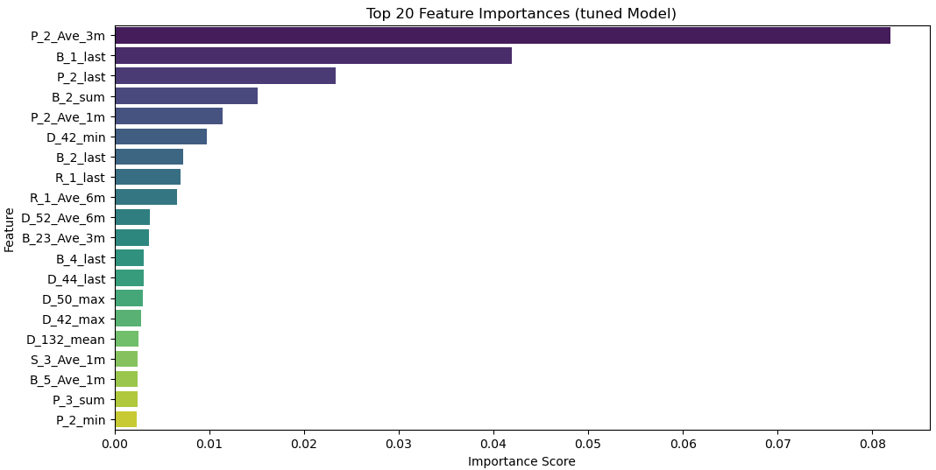
Feature Selection
The features that were chosen have a feature importance greater than 0.5 percent. When making predictions, features with higher importance are considered more informative and are given more weight in making predictions. By concentrating on the most relevant data, this enhances the predictive model's efficiency and accuracy.
Variable Types | No of Features | No of Selected Features
Delinquency variables | 139 | 5
Balance variables | 52 | 4
Risk variables | 28 | 3
Spend variables | 22 | 2
Payment variables | 3 | 1

Slide 8
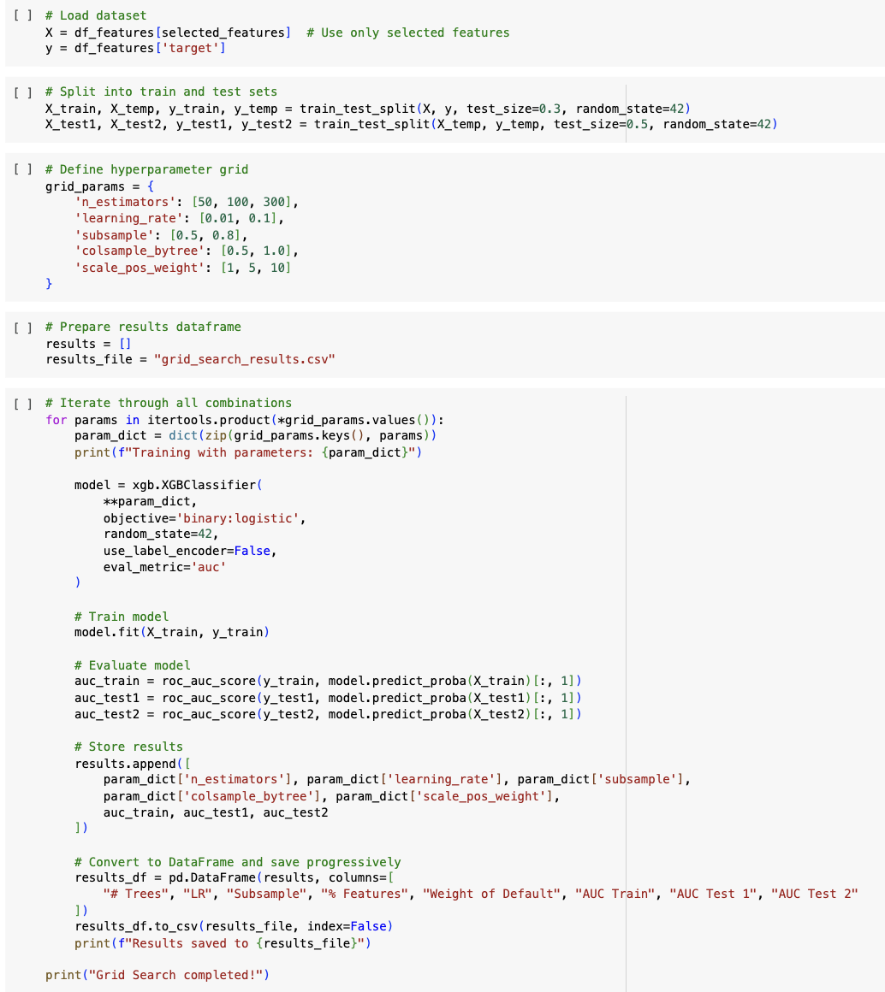
XGBoost - Grid Search
Reasons for employing custom parameters in the XGBoost model include:
Increasing the number of trees to 300 enables the model to capture more complex patterns in the data without requiring additional preprocessing.
Using a higher learning rate (0.5) helps small datasets by accelerating the model’s ability to learn new information more quickly.
Restricting the tree depth to 4 prevents overfitting and avoids excessively complex tree structures.
Applying a subsampling rate of 0.5 introduces randomness and diversity into training while reducing the risk of overfitting, especially when using a higher learning rate.
Incorporating sample weights addresses dataset imbalances, leading to a more stable and accurate model.

Slide 9
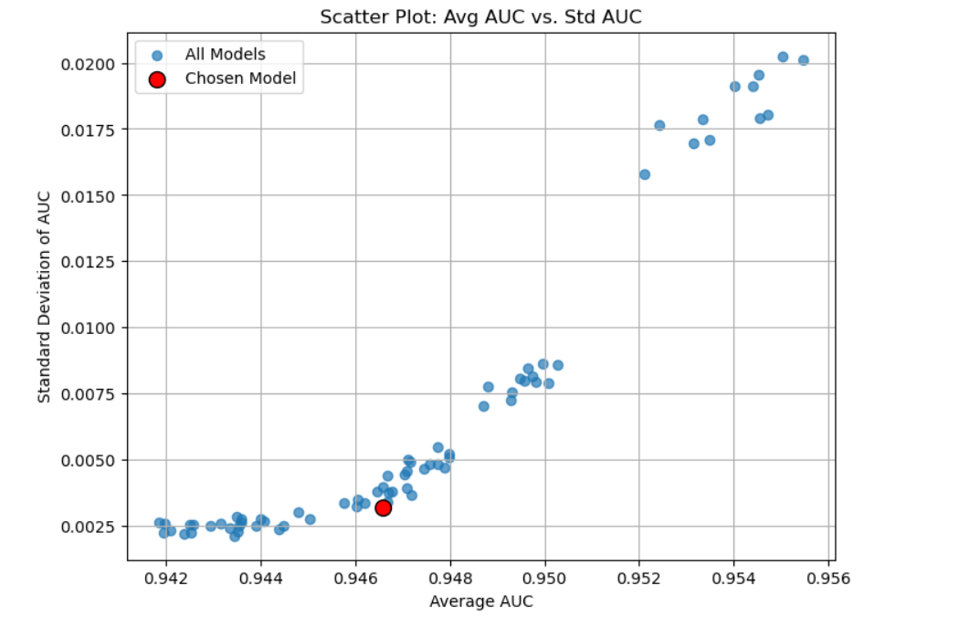
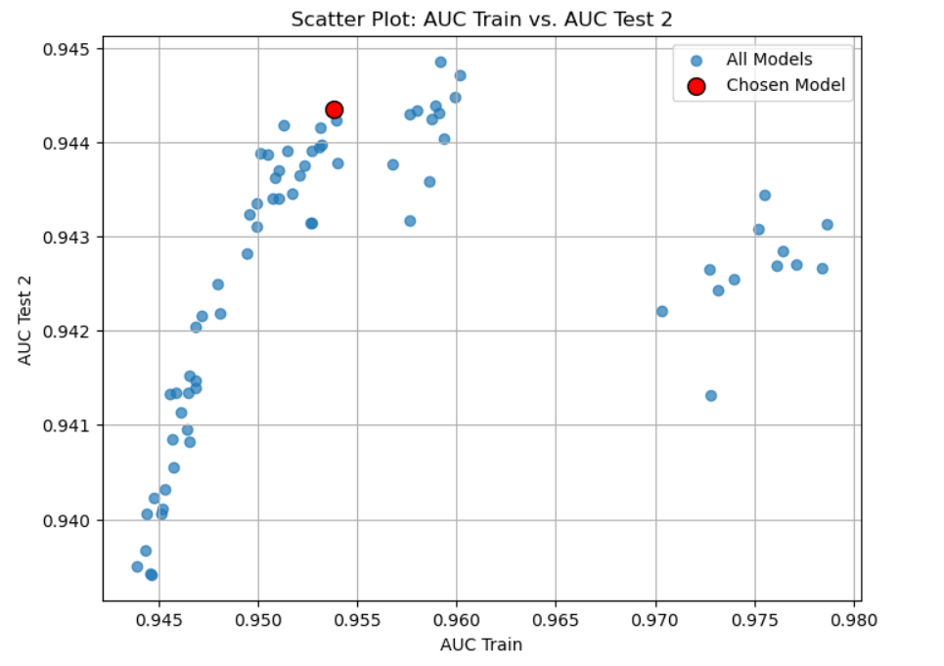
XGBoost - Grid Search
An ideal model would have low variance (standard deviation of AUC) while still having a high Average AUC. The red circle represents the model with a good balance between low variance and high AUC.
The ideal model has a high AUC Test 2 and minimal overfitting, where AUC Train ≈ AUC Test 2. Red-circled points highlight potential models with strong test performance and minimal overfitting.

Slide 10
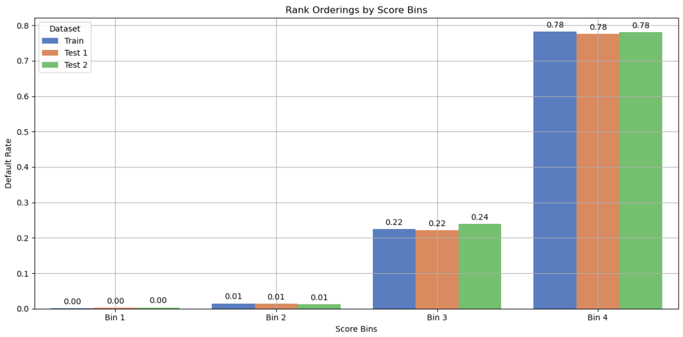
XGBoost – Final Model

Slide 11
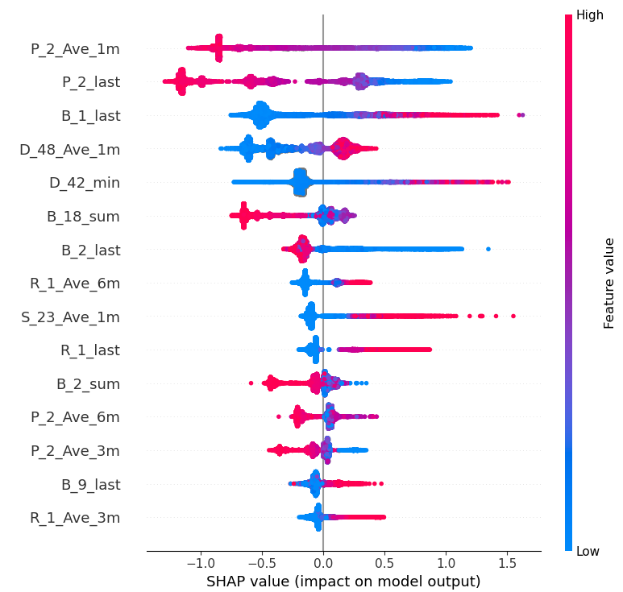
XGBoost – SHAP Analysis
BEESWARM GRAPH
The top five features, in order, are P_2_Ave_1m, P_2_last, B_1_last, D_48_Ave_1m, and D_42_min.
P_2_Ave_1m and P_2_last is negatively impacted since negative SHAP values are more frequently linked to greater feature values.
A range of consequences is indicated by B_1_last, which shows both positive and negative affects.
Because positive SHAP values are more closely linked to larger feature values, D_48_Ave_1m and D_42_min regularly exhibit favourable impacts.

Slide 12
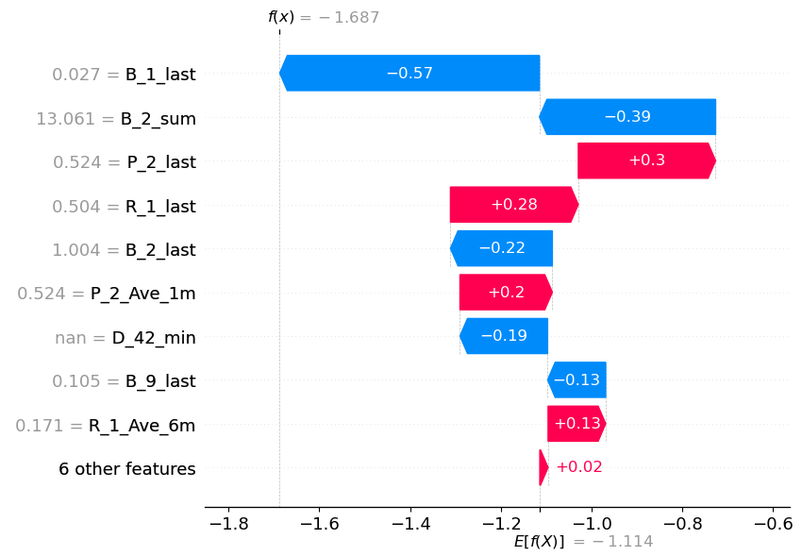
XGBoost – SHAP Analysis
Interpretation of the Waterfall Chart:
The top 5 features, in order, are B_1_last, B_2_sum, P_2_last, R_1_last, and B_2_last, showing a shift from the global feature importance ranking.
B_1_last, B_2_sum, and B_2_last are negatively impacting the model.
P_2_last and R_1_last are contributing positively to the model.
Strategies for Improving the Score:
Focus on selecting features that have a significant impact on the target variable, while discarding irrelevant or redundant ones to minimize noise.
Optimize the hyperparameters of the machine learning model.
Continuously iterate on the model-building process to make incremental improvements.

Slide 13
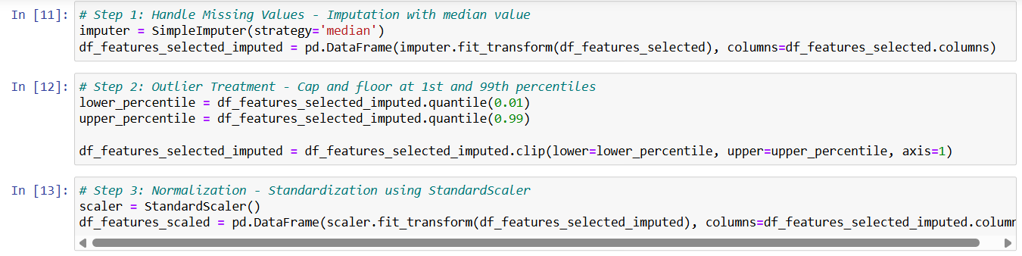
Neural Network – Data Processing
Imputation:
• Fill the null values with the median.
Outlier Treatment:
• We established quantile ranges on the training data and applied them to the test data for transformation.
Scaling:
• Utilizing a StandardScaler, we fitted it with the training data to enable transformation of the test datasets.

Slide 14
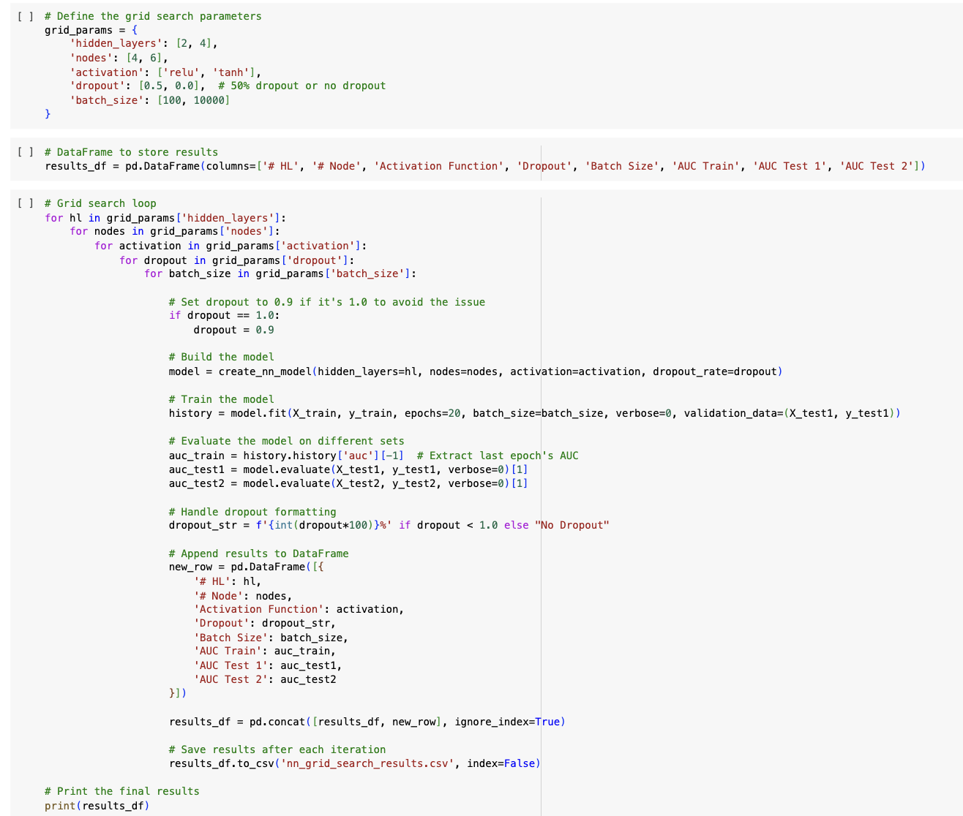
Neural Network - Grid Search
Reasons for Using Custom Parameters in a Neural Network Model:
More hidden layers help the model learn complex patterns.
Increasing nodes per layer boosts capacity but requires balance to avoid overfitting.
ReLU works well for simpler tasks; Tanh suits more complex patterns.
Dropout (0.5) improves generalization by reducing reliance on specific neurons.
Small batch sizes (e.g., 100) can lead to overfitting due to frequent updates.
Large batch sizes (e.g., 10,000) may underfit by updating weights too infrequently.
Epochs control how many times the model cycles through the dataset.

Slide 15
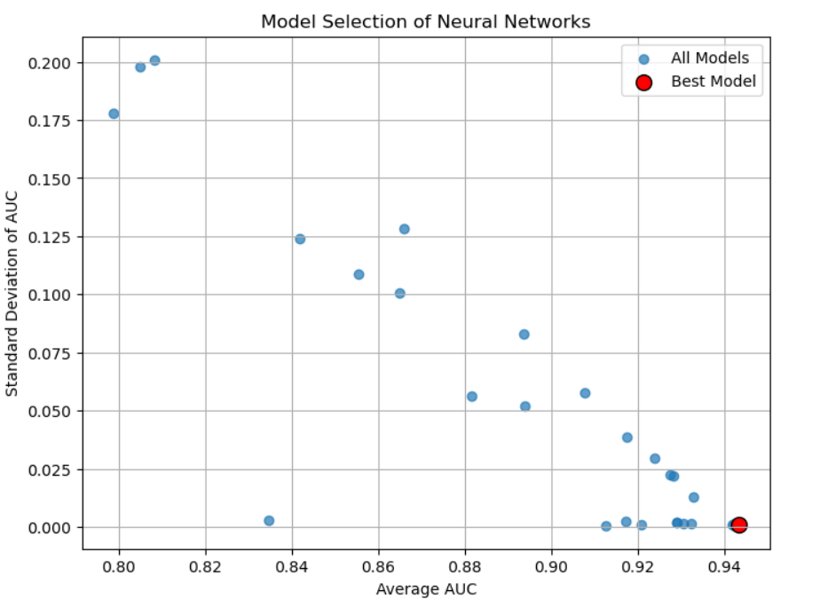
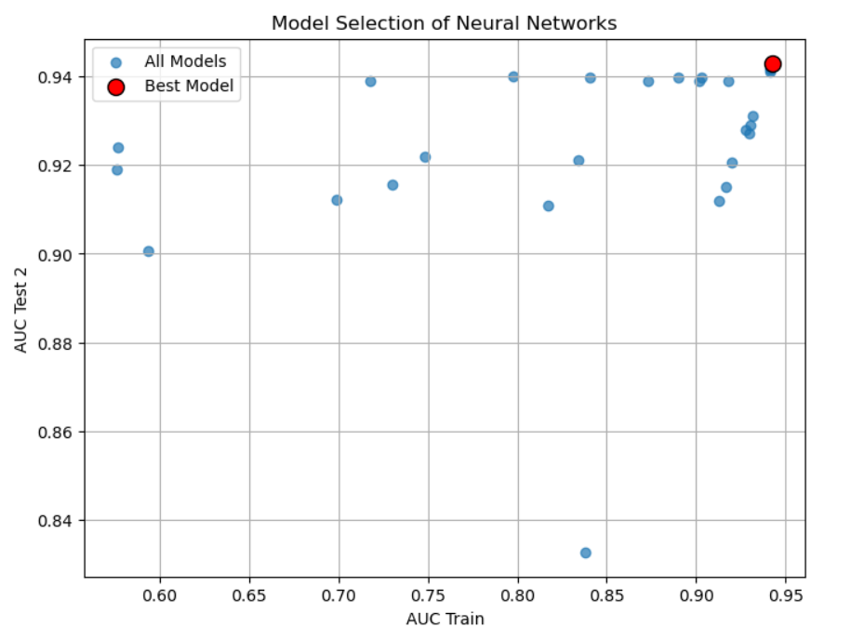
Neural Network - Grid Search
Create scatter plots for models of grid search, & will choose best model based on scatter plot.
For each grid search models, calc avg & stdev of auc across 3 samples (train and tests).
Then include 2 scatterplots in this slide.
First one - Avg AUC (x-axis), stdev of AUC (y-axis)
Sec one - AUC of train sample (x-axis), AUC of test 2 sample (y-axis)
Explain which model you would choose based on each scatter.

Slide 16
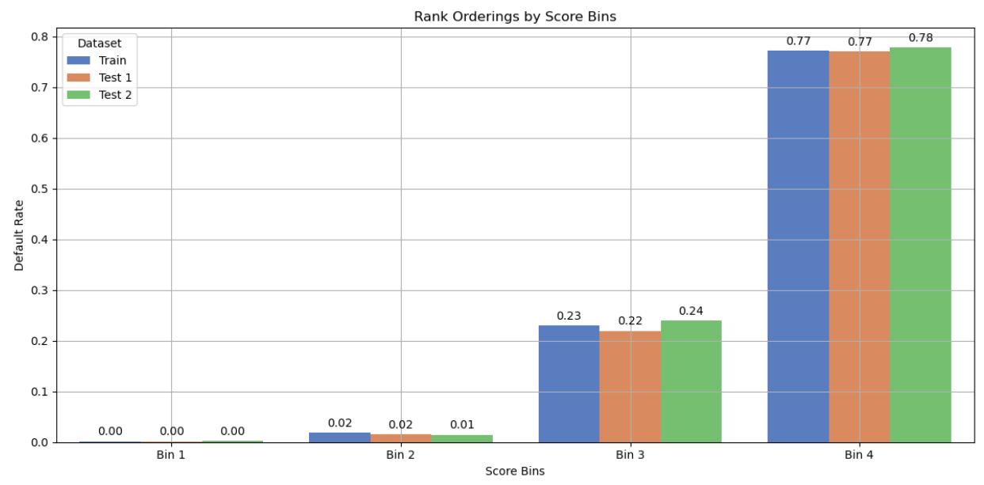
Neural Network – Final Model

Slide 17
Final Model
Neural Network Model Performance:
XGBoost Model Performance:
The XGB model has slightly higher AUC values for both training and testing datasets compared to the Neural Network Model.
A higher AUC indicates better model performance in terms of correctly classifying positive and negative instances.
The interpretability and speed of the XGBoost Model is also higher than Neural Networks.

Slide 18
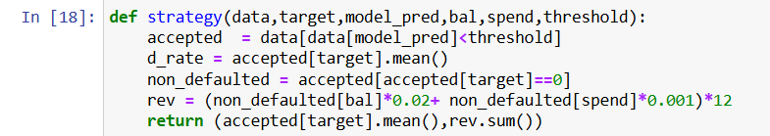
Strategy
 | Threshold | Default rate_Train | Revenue_Train | # Total_Train | Default rate_test1 | Revenue_test1 | # Total_test1 | Default rate_test2 | Revenue_test2 | # Total_test2
0 | 0.1 | 0.012922 | 2802.624262 | 64248 | 0.011050 | 121.400358 | 13767 | 0.011406 | 125.902438 | 13768
1 | 0.2 | 0.032865 | 3404.298493 | 64248 | 0.030817 | 149.683356 | 13767 | 0.031879 | 155.341311 | 13768
2 | 0.3 | 0.066485 | 3925.646913 | 64248 | 0.064432 | 175.060565 | 13767 | 0.065989 | 179.150701 | 13768
3 | 0.4 | 0.101141 | 4304.725999 | 64248 | 0.097116 | 191.242350 | 13767 | 0.102779 | 197.052668 | 13768
4 | 0.5 | 0.133063 | 4555.326684 | 64248 | 0.131255 | 200.905021 | 13767 | 0.134443 | 208.870774 | 13768
5 | 0.6 | 0.163657 | 4700.229417 | 64248 | 0.162615 | 206.109609 | 13767 | 0.164722 | 215.205545 | 13768
6 | 0.7 | 0.191816 | 4772.694469 | 64248 | 0.192501 | 209.287820 | 13767 | 0.193605 | 217.663799 | 13768
7 | 0.8 | 0.220136 | 4810.796336 | 64248 | 0.220981 | 211.745667 | 13767 | 0.222819 | 219.111952 | 13768
8 | 0.9 | 0.246136 | 4834.801592 | 64248 | 0.246999 | 212.464319 | 13767 | 0.248765 | 220.549379 | 13768
9 | 1.0 | 0.255883 | 4840.905666 | 64248 | 0.256556 | 212.608066 | 13767 | 0.259370 | 220.549379 | 13768

